Slide 1

Session #2: Continue Building
SIGN IN: http://tinyurl.com/cube-session-2

Slide 2
JAck Sopotnick
Leonidas Lavdas
Ramiro Juarez
Christopher Cooper
Evan Gruda
Sabrina Edelmann
Joshua Mendieta
Cameron Soviero
Andy John Baptiste
Lars Bjorndal
Szilard Beres
Kyle Cheng
Rony Schutz
Juan Ospina
Jorge rengel
Jared Franco
Tyler Edwards
Camilo Chen
Thomas Wagoner

Slide 3
Parts List
Step 1: Check Parts
27x LED
3x 220Ω Resistors
1x ATmega328P (Nano microcontroller)
12x Male-to-Male Rainbow wires
1x USB 2.0 A to Mini-B
2x cardboard spacers
1x cardboard base
1x wood base
24x metal poles

Slide 4
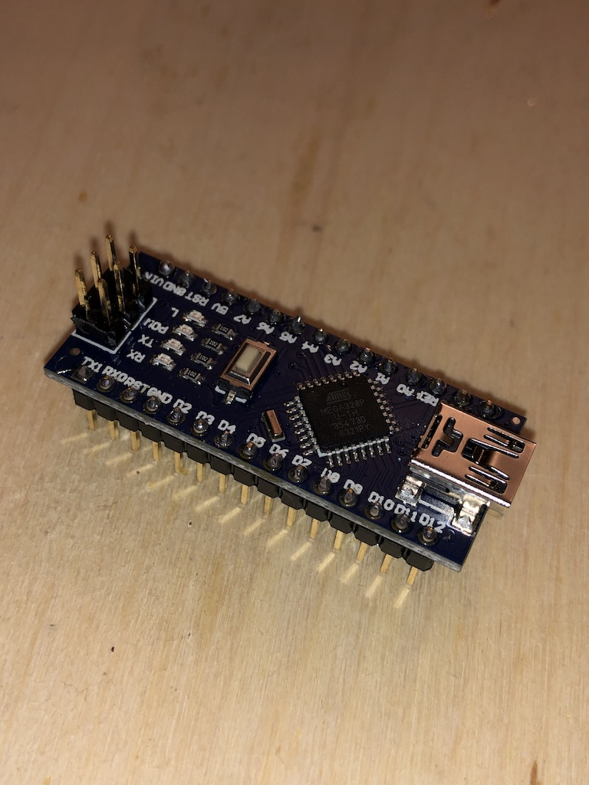
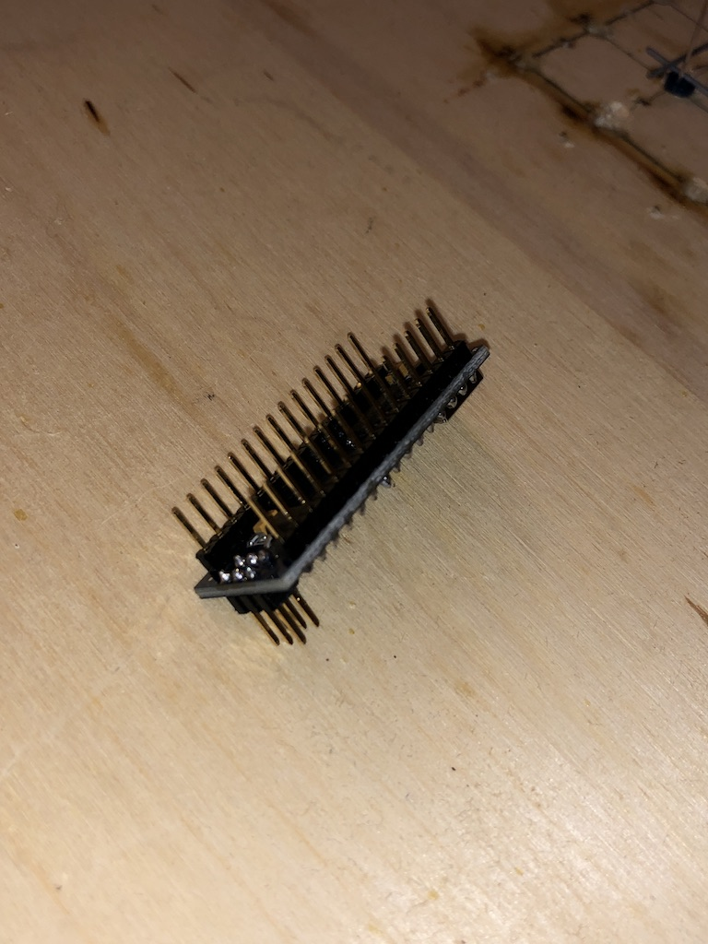
The Build
Step 0:
Place the ATmega328P in a breadboard to hold for soldering
Solder 3 sets of pins in correct orientation

Slide 5
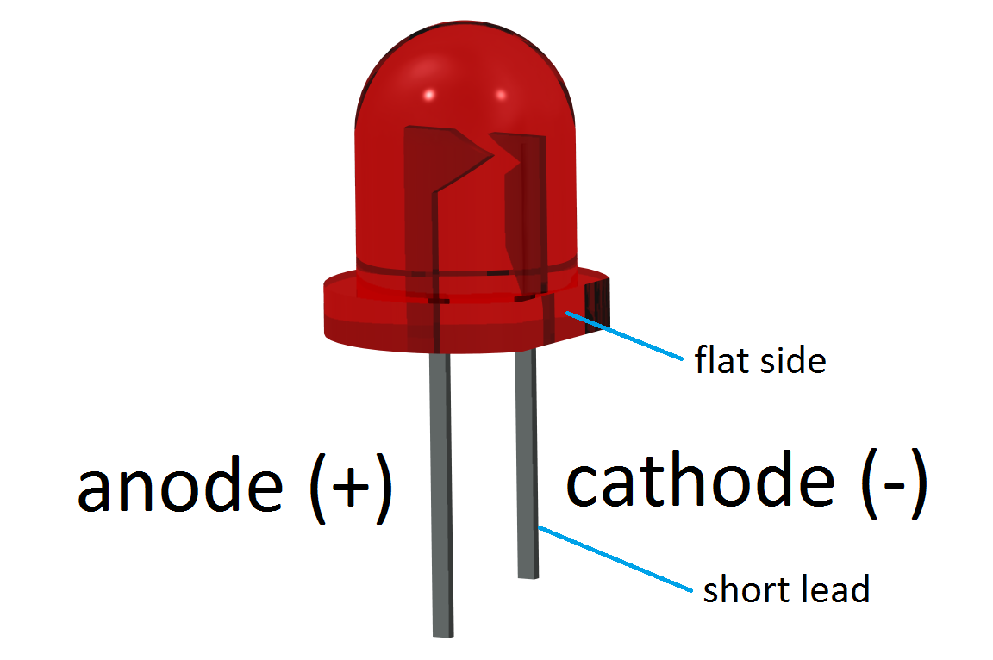
LED mnemonics: - It is assumed that being tall is positive…want another one? - Negative gets the short end of the stick…you will never forget this!

Slide 6
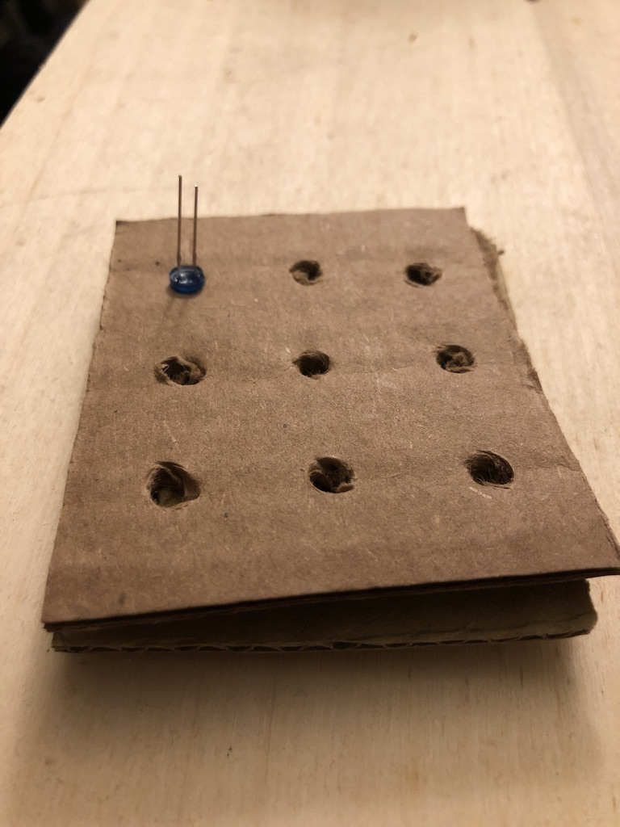
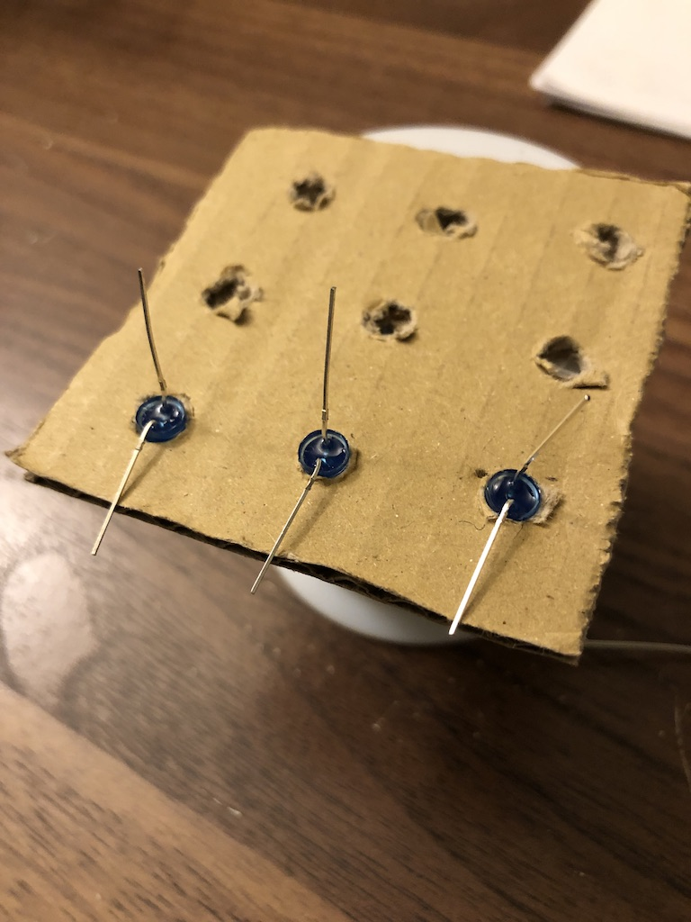
The Build
Step 1:
Notice anode(long leg) and cathode(short leg)
Bend cathode down facing outward
Leave the anode facing up throughout the entire layer build. (There will be 3 layers)

Slide 7
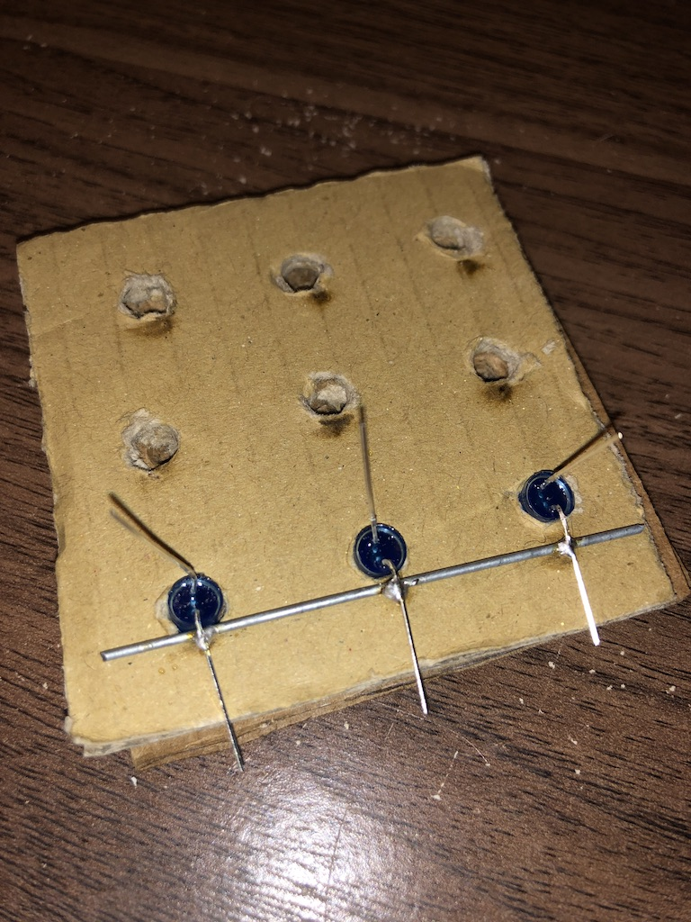
The Build
Step 2:
Place a pole under the 3 cathode legs
Use legs to hold pole is place
Solder legs
You can use one finger to push down on the anode to help keep the pole in place if needed

Slide 8
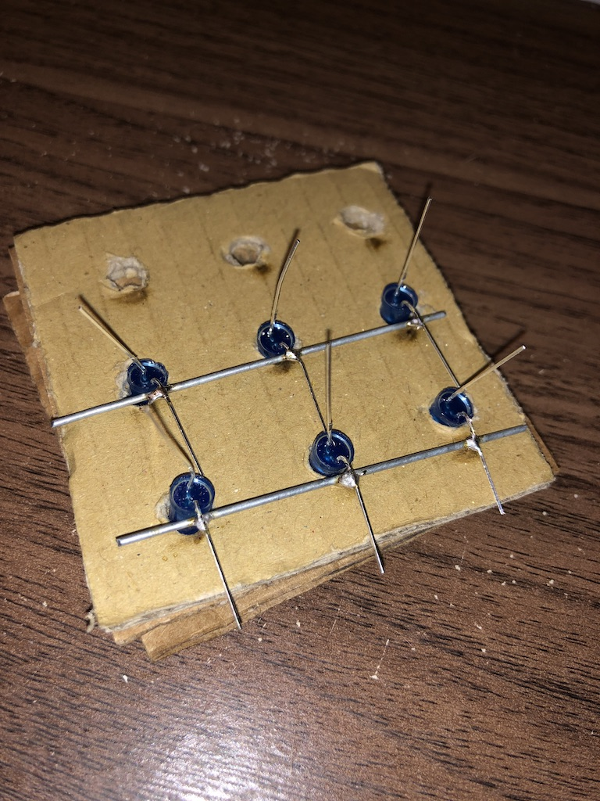
The Build
Step 2a:
Repeat for the second set of LEDS

Slide 9
The Build
Step 2b:
Repeat for the second set of LEDS

Slide 10
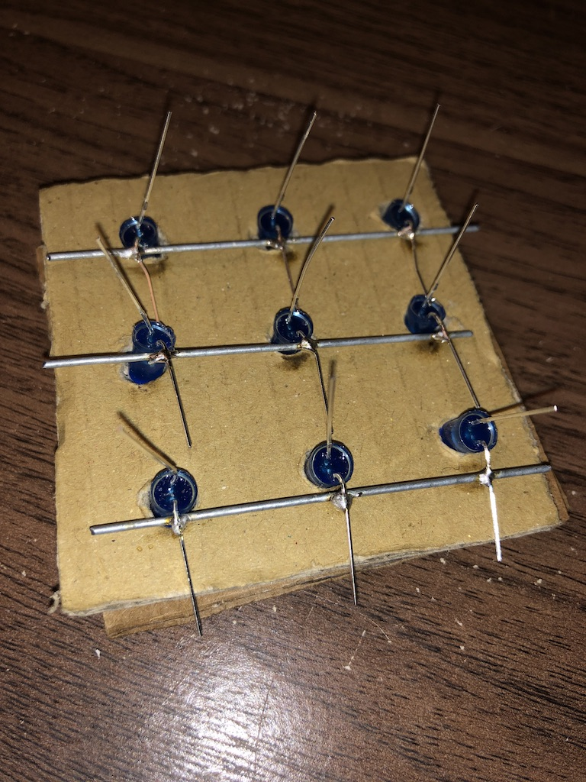
The Build
Step 2c:
Repeat for the third set of LEDS

Slide 11
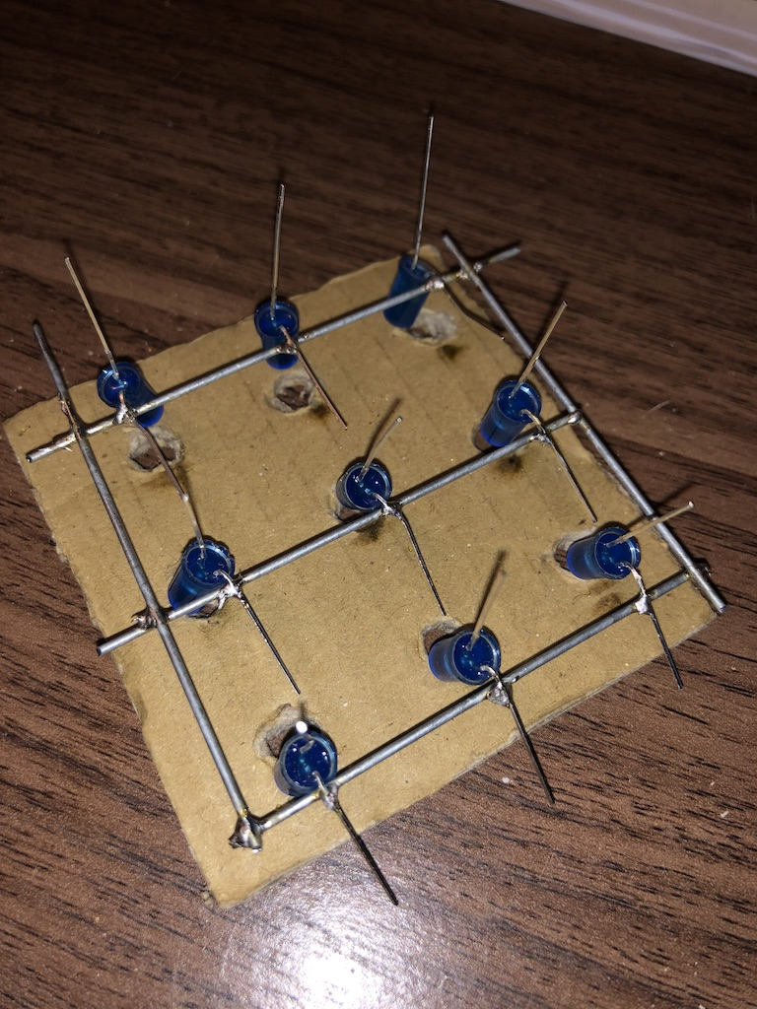
The Build
Step 3:
Place a pole on each end
Solder the 6 joints

Slide 12
The Build
Step 3:
Place a pole on each end
Solder the 6 joints
Cut excess cathode off

Slide 13
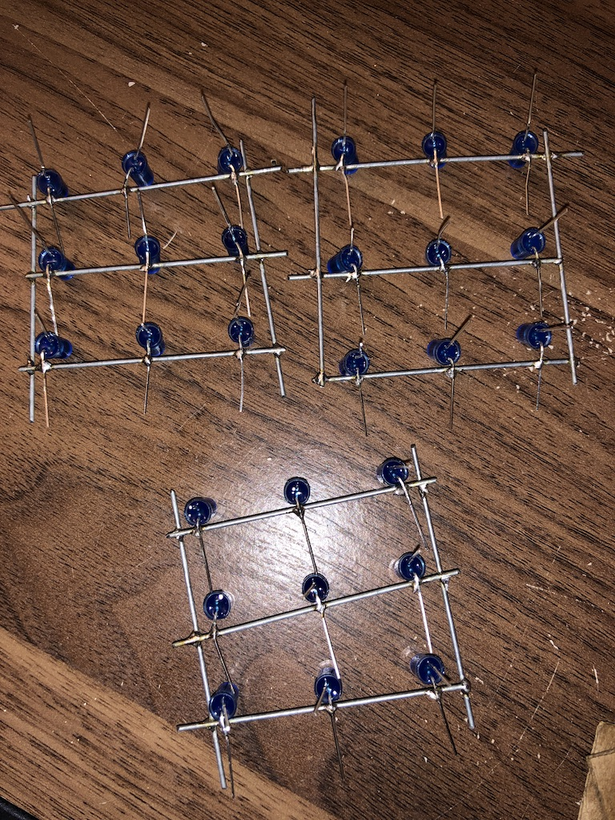
The Build
Step 4:
Repeat same process of steps 1-3 for 2 more layers!
The angles DO NOT have to be perfect, but try your best to keep things lined up
Cut any additional cathode legs off, but nothing else
Anodes should still be pointing upwards

Slide 14
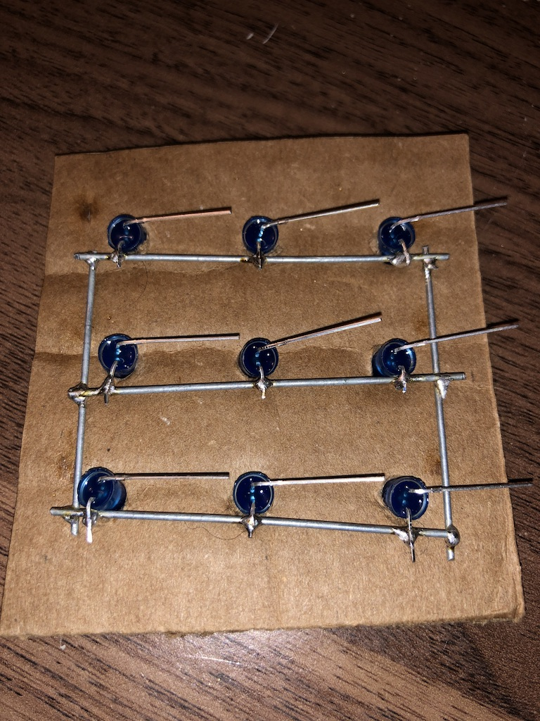
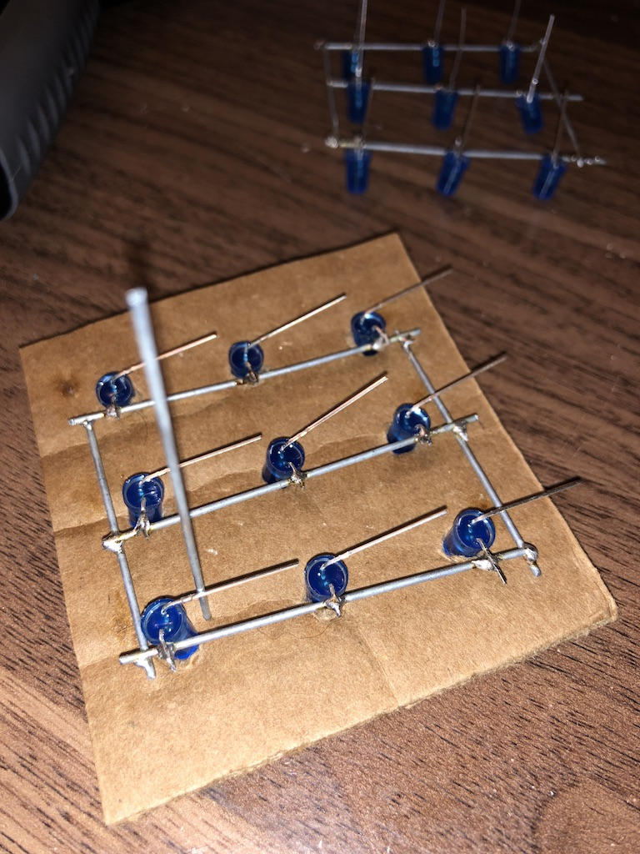
The Build
Step 5:
Place one layer onto wood base, and then bend all anode legs in the direction specified. (You can do this multiple ways, but I found worked well)
This step may take 2 people, so be prepared to help your neighbor
Place one pole near an anode leg and solder pole so that it is facing upwards

Slide 15
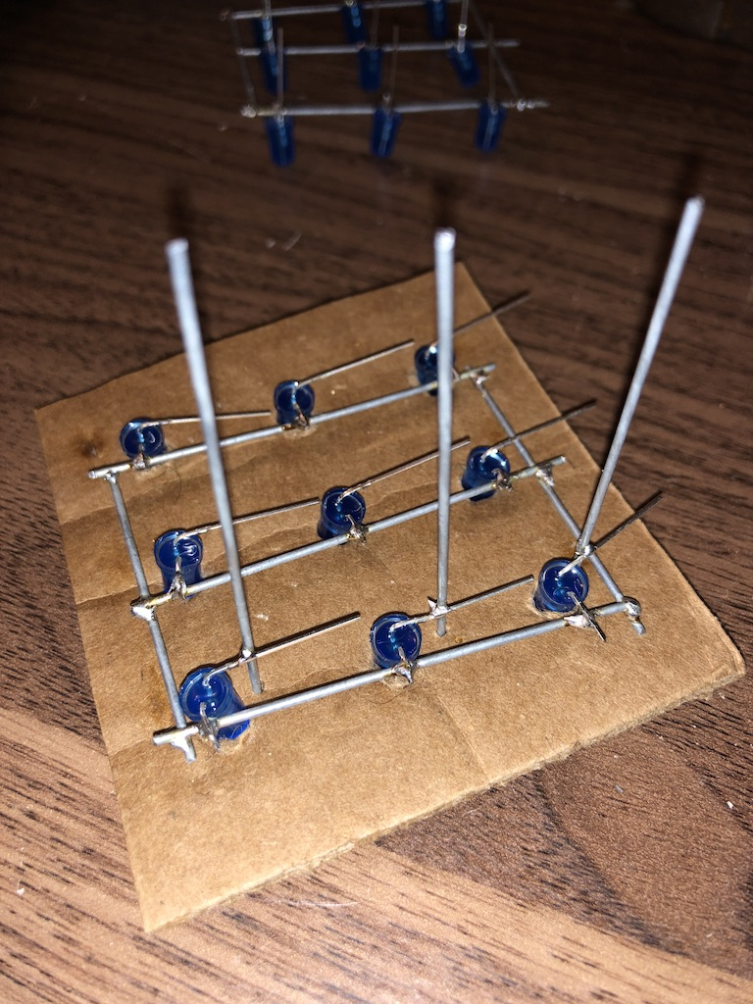
The Build
Step 6:
Repeat for the next 2 LED anodes on that row
Check to make sure your leg closest to the cathode common ground layer IS NOT touching
Bend the leg outward some if it is

Slide 16
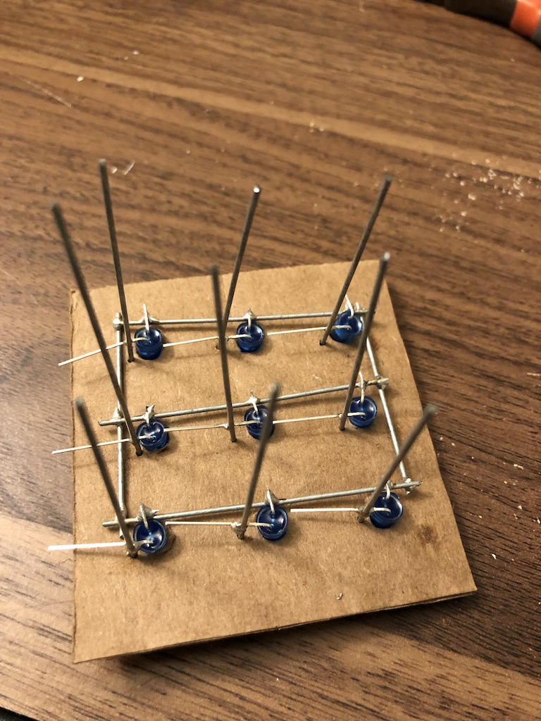
The Build
Step 7:
Repeat for the next 2 columns
If you are that the anode legs are cleared from the cathode layer, cut excess anode off

Slide 17
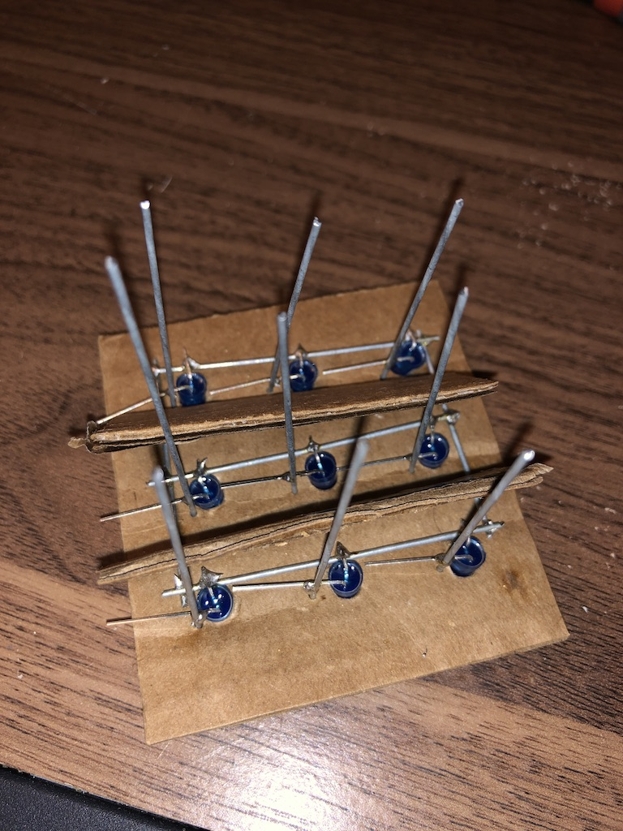
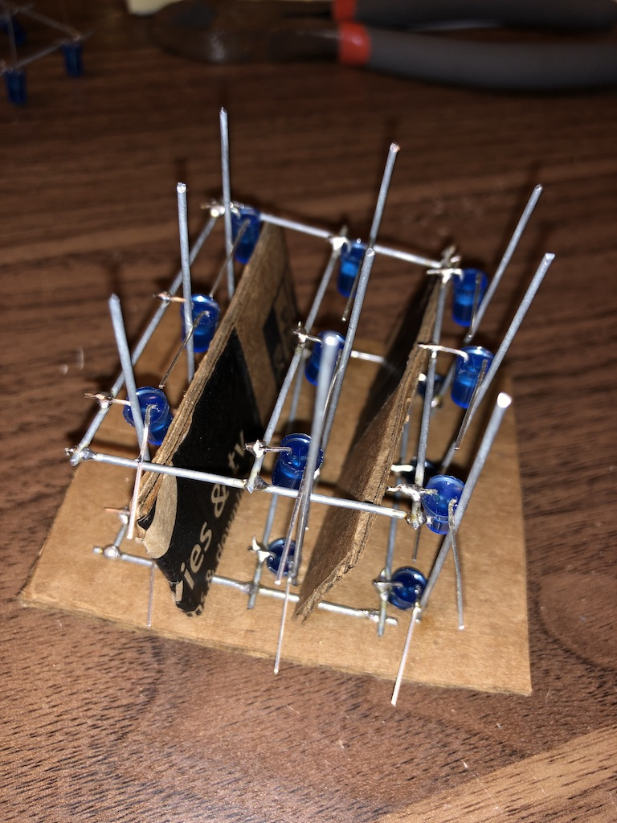
The Build
Step 8:
Place cardboard spacer on top of bottom layer, and place another layer on top
Try to line up your poles with the anode legs to make the soldering process easier
Repeat steps 5-7

Slide 18
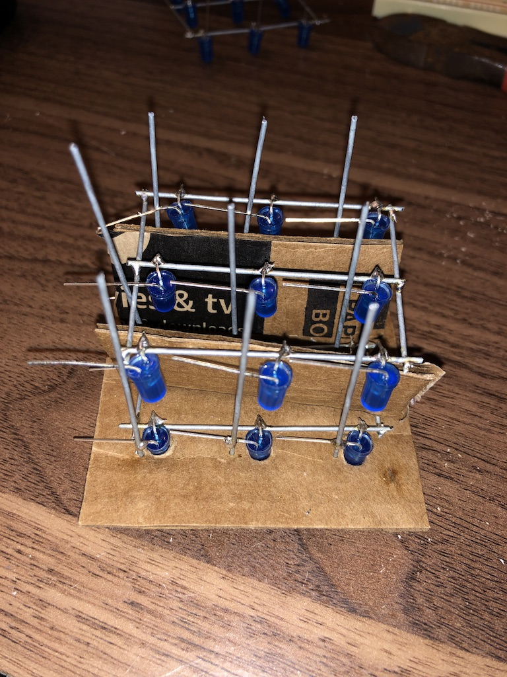
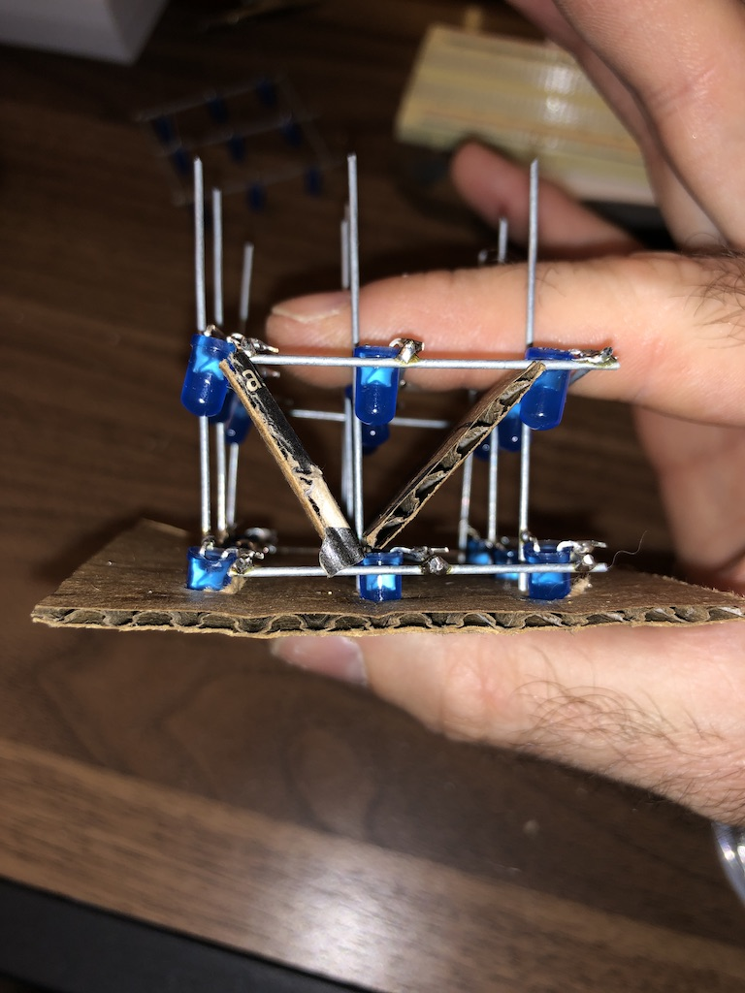
The Build
Step 8 continued:

Slide 19
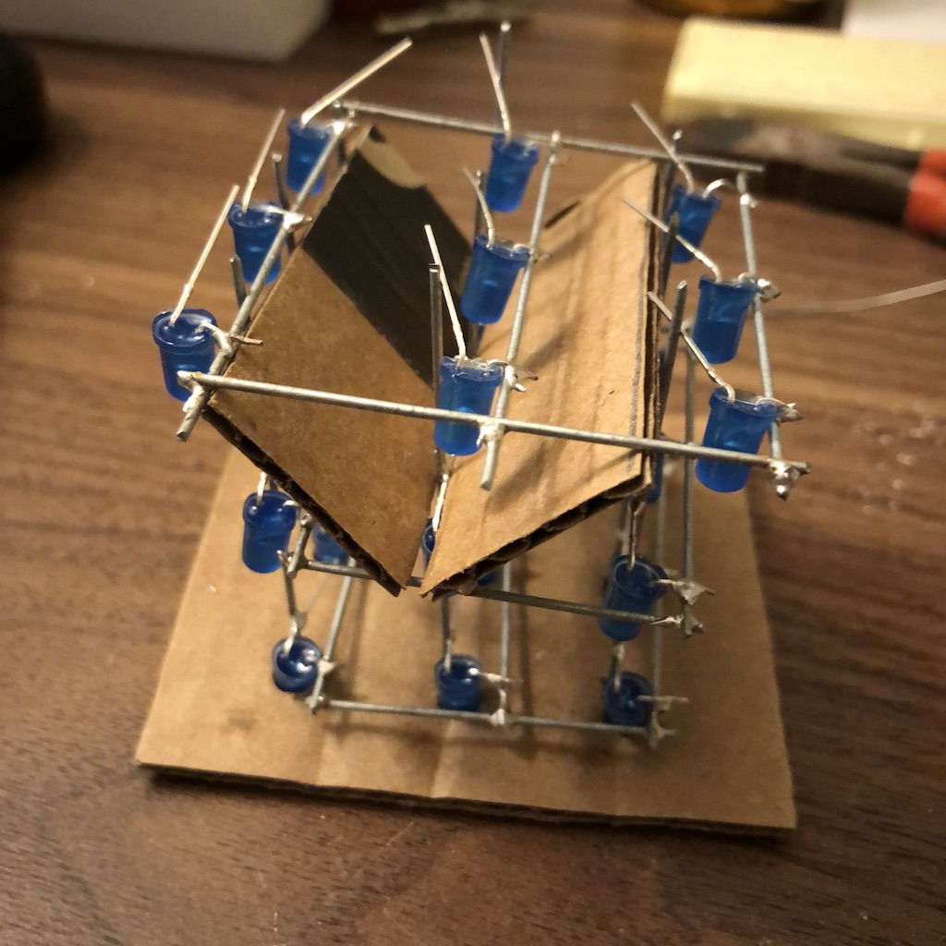
The Build
Step 9:
Place cardboard spacer on top of second layer, and place the last layer on top
Try to line up your poles with the anode legs to make the soldering process easier
If your vertical poles are a little too short, then just bend your anode downward to reach it. (The distance should be relatively small)
Repeat steps 5-7

Slide 20
The Build
Step 10:
Trim all excess legs and poles
BE CAREFUL, the poles will shoot off with great force

Slide 21
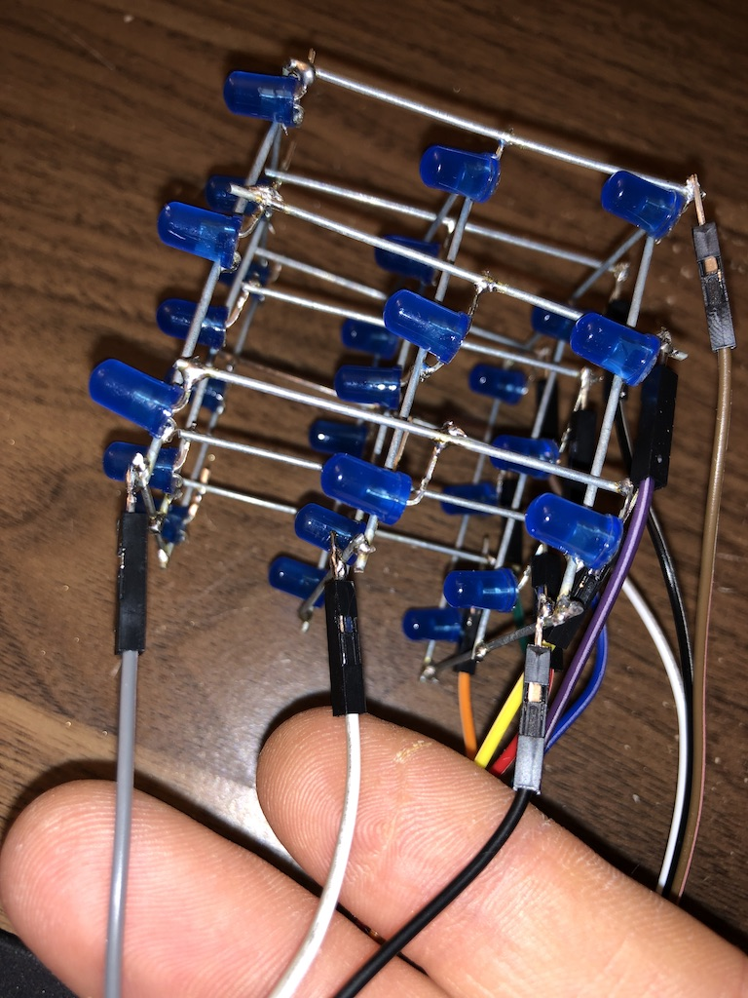
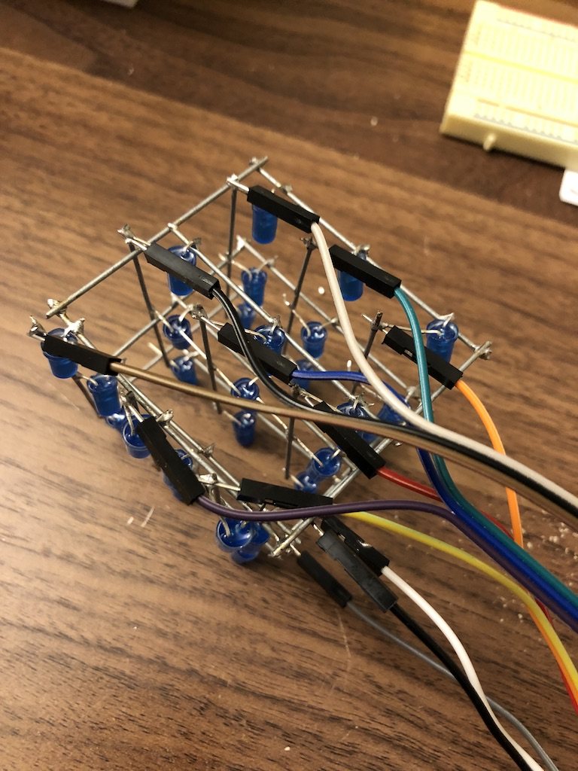
The Build
Step 11:
Use 3x rainbow male-to-male wires to solder to cathode common ground layers(1x per layer)
Use the other 9x wires to solder to each anode pole
Preferably have all the wires coming out of the same side and laying relatively flat
DO NOT hold the soldering iron on the wire tip too long. The wire will get very hot and melt the plastic!

Slide 22
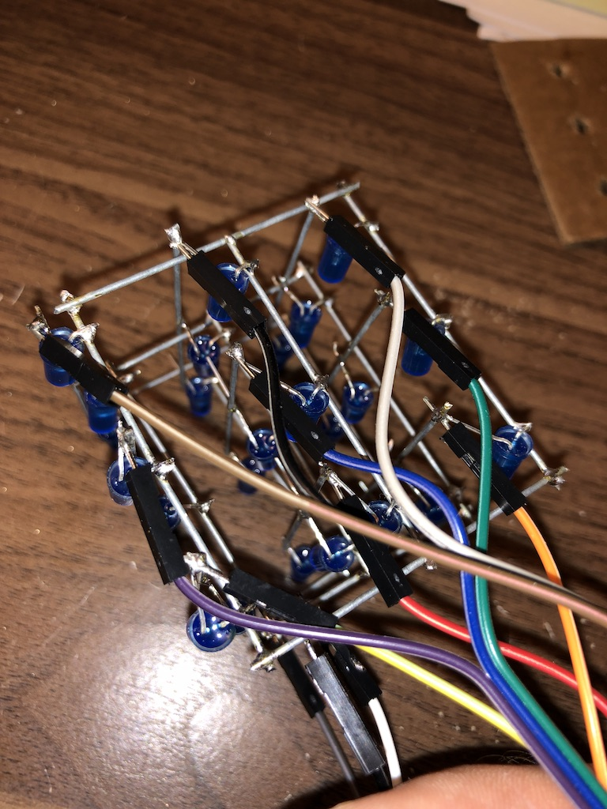
The Build
Step 11 continued:
Check that all connections are secure
Make sure no anode poles are touching the cathode layers. They can easily be bent out of the way if one is. ( We will also find out when power is supplied)

Slide 23

Test with session1_test.ino at https://github.com/tama853/LED_CUBE_SESSION if finished in time
THE BUILD IS COMPLETE!

Slide 24
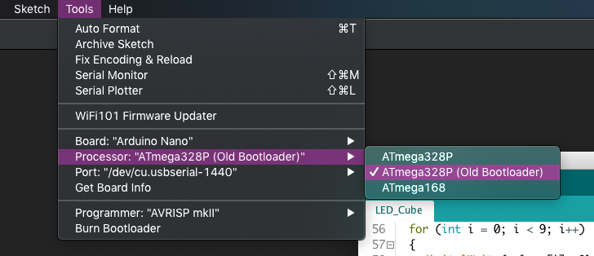
Test with session1_test.ino at https://github.com/tama853/LED_CUBE_SESSION if finished in time
Check IDE Settings!

Slide 25
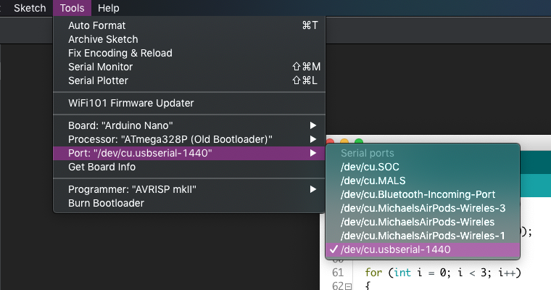
Test with session1_test.ino at https://github.com/tama853/LED_CUBE_SESSION if finished in time
Check IDE Settings!

Slide 26
Session 2: Finish Build, Start Programming
Download the Arduino IDE: https://www.arduino.cc/en/Main/Software
Setup Github account
Bring laptops
Leave cubes and Nano with your name or identifying marker to continue for next week
See you next week for the final showdown!

